Slide 1

Spoiled Beverage Detector
Vanessa Mathew , Bahar Rahmani
Kymbat Talant , Jahangir Esfandiari
Solution Design in Medical Engineering
Medical Systems Engineering

Slide 2

Overview
Introduction
Biochemistry of Beverages
Current Technology
Functions & structures
Possible designs
Gas sensor
PH meter
Final design
Outlook

Slide 3
Introduction
Consuming Expired Drinks
Stomach cramp, Fever, Vomiting, Nausea, Diarrhea, etc.
Detecting spoilage takes time
Children not aware of the early signs of expired drinks

Slide 4

Introduction
Objective
Development of a device for fast detection of spoiled drinks & report of results

Slide 5
Early Findings: Fruit Juices Property
Fruit juices have pH in the acidic range (<4.5) becomes conducive for bacterial growth
Freshly squeezed juice, is highly susceptible to spoilage more than whole fruit
Table 1: PH level of different fruit juices [4]
Juices | pH range | Mean
Orange | 4.19–4.50 | 4.34
Sweet lime | 4.70–5.47 | 5.08
Carrot | 5.76–6.03 | 5.89
Notes:
From this table, we can see the different pH values of different types of juices
As we know, the pH value of fruit juices lie in a wide range of between 6 – 4 and especially for juices with a pH level lower than 4.5, becomes conducive for microbial growth
And this is also especially true for squeezed juice as they are more susceptible for spoilage than whole fruit

Slide 6
Critical factors affecting the spoilage of juices
Table 2: Intrinsic & Extrinsic Properties for Juice Spoilage [2]
Intrinsic | Extrinsic
Juice pH | Storage temperatures and times
Water activity | Relative humidity conditions during storage and packaging material characteristics.
Effects:
Development of off-flavors
CO2 production
Changes in color, texture, and appearance
Notes:
Here are some of the intrinsic (internal) and extrinsic(external) factors that affect fruit juice spoilage
Effects include: ….

Slide 7
Composition of cow‘s milk
The pH value of normal milk is in the range between 6.6-6.8 at 25°C
Table3: Quantitative composition of milk [6]
Main constituent | Limits of variation | Mean value
Water | 85.5 – 89.5 | 87.5
Fat | 2.5 – 6.0 | 3.9
Proteins | 2.9 – 5.0 | 3.4
Lactose | 3.6 – 5.5 | 4.8
Minerals | 0.6 – 0.9 | 0.8

Slide 8
Early Findings: Different milk properties
Table 4: Milk forms [4]
Raw Milk | A wide variety of germs
Pasteurized Milk | Coxiella burnetti, Poreformers, Listeria Monocytogenes, Coliforms.
Condensed Milk | Glaucus, Aspergillus repens, Torulopsis.
Dried Milk | Bacillus, Micrococcus, Mucor

Slide 9
Biochemistry
PH range of beverages
Juices | pH range | Mean
Orange | 4.19 - 4.50 | 4.34
Sweet lime | 4.70 - 5.47 | 5.08
Carrot | 5.76 - 6.03 | 5.89
Milk | 6.6-6.8 | 6.7
Table1: PH level of different drinks [1]

Slide 10
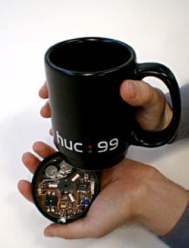

Current technologies
Media cup
Representing content information (e.g. temperature)
Components
sensors
Microprocessor
capacitors
Infrared
network
Software
Fig.1. Media cup Prototypes,
Gellersen et al. International Symposium on Handheld and Ubiquitous Computing (1999)

Slide 11
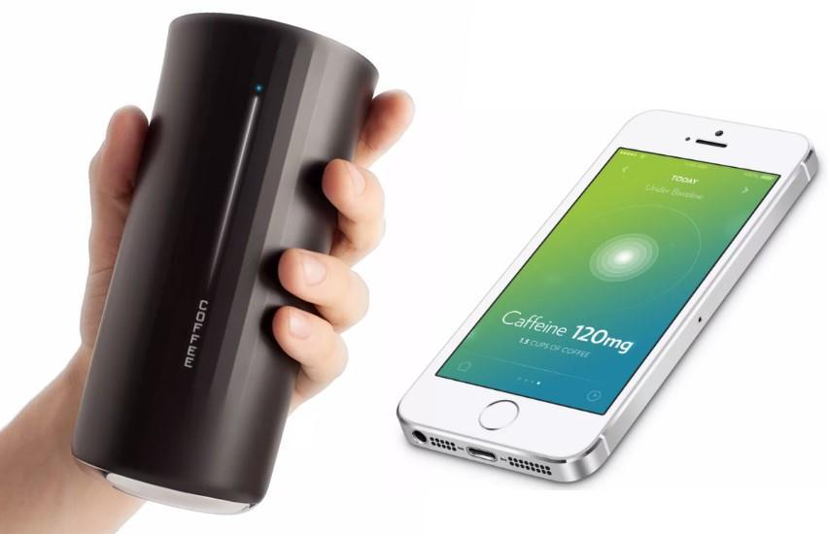
Current technologies
Vessyl
Detecting amount & type of beverage
Information displayed on side of cup
Mobile App to track every sip
Indication of sufficient hydration by blue light
Fig.2. Vessyl smart cup,
http://hiconsumption.com/2014/06/vessyl-smart-cup/

Slide 12
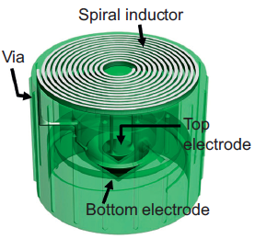
Current technologies
Smart cap
Sensing quality of liquid in fluidic package
Based on changes in capacitance
Resonance frequency shifts of the LC tank via an inductive reader
LC tank as wireless-resonant sensor
Passive operation without power consumption
Fig.3. Design of a wireless “smart cap”, [5]

Slide 13
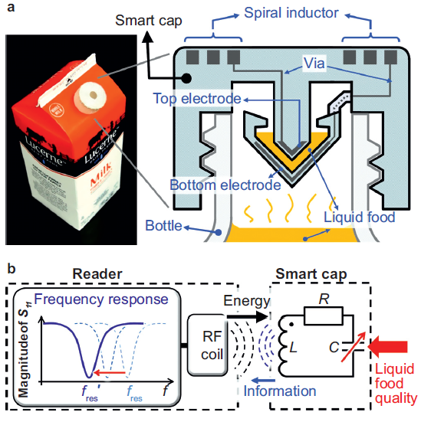
Current technologies
Smart cap
Fig.4. (a) smart cap with milk package (b) LC resonant circuit, [5]

Slide 14
Why Milk?
Selection of 1 type of drink to detect – Pasturized Milk
Easier to detect spoiled milk than spoiled juices
Spoiled juices have a wide range of pH value between different fruits
Health issues in third world countries
Human senses are often inadequate
Important nutrients for humans as wells as for animals

Slide 15
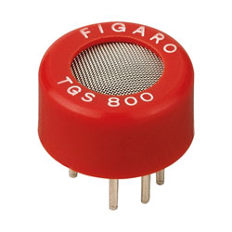
Possible designs
Gas sensor
Use of a gas sensor TGS 800
Closed measuring chamber
Power Supply
Voltmeter
Fig.5. TGS 800 sensor,
https://ciiva.com/part/tgs-800-13645760

Slide 16
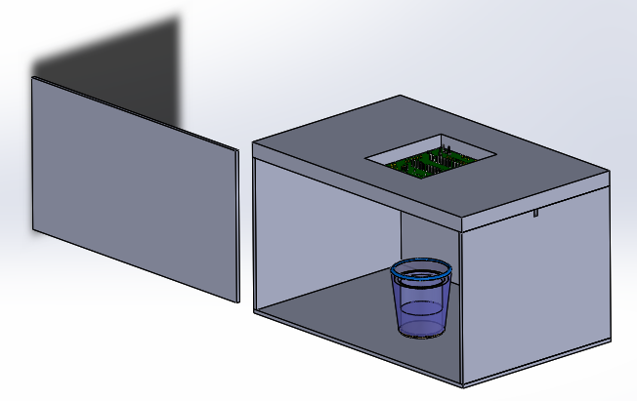
Possible designs
Gas sensor
Fig.6. Enclosed Glass Box Drawing, done by Solid Works

Slide 17

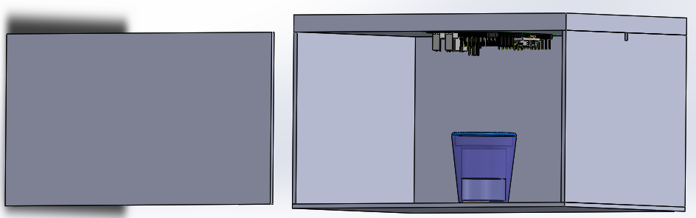
Possible designs
Gas sensor
Gas Sensors
Hole for Wiring
Polymer
Glass
Spoiled Milk
Fig.7. Enclosed Glass Box Drawing, done by Solid Works

Slide 18
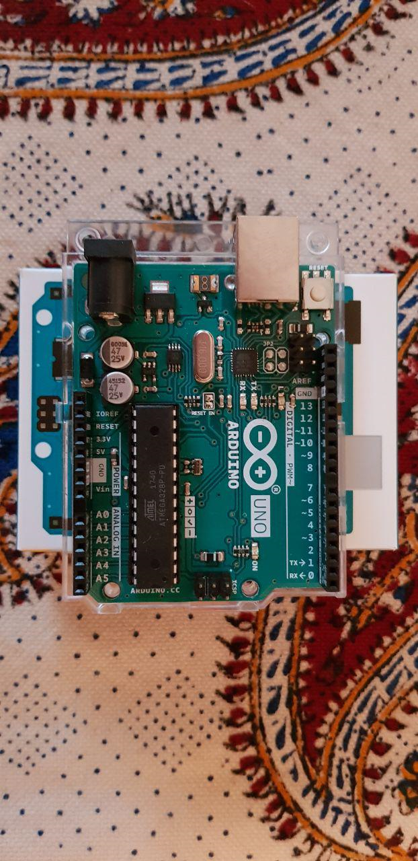
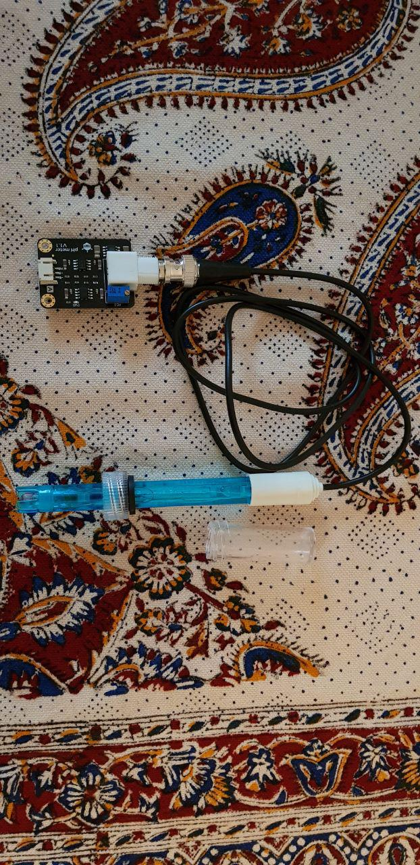
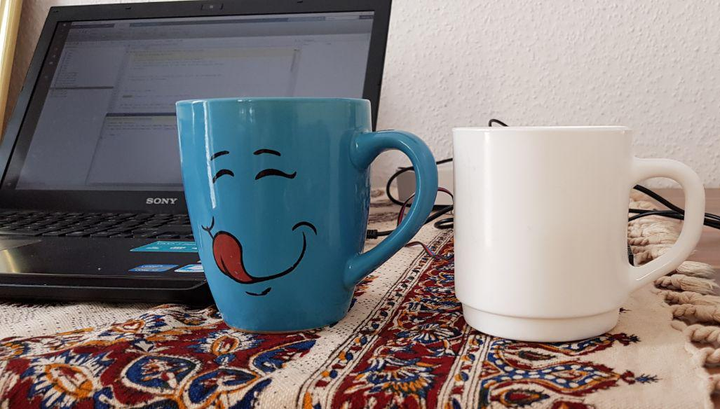

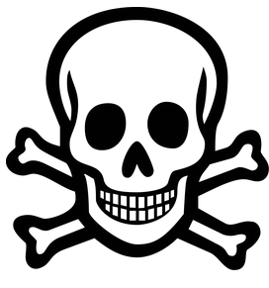
Final design
Rduino Microcontroller
PH meter
Fig.8. Prototype of spoiled beverage detector

Slide 19
Final Design
Demonstration of healthy milk detection

Slide 20
Final Design
Demonstration of sour milk detection

Slide 21



Data Management and Blog

Slide 22
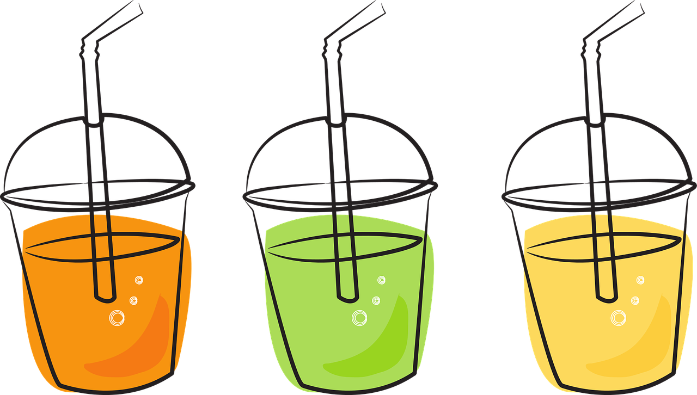

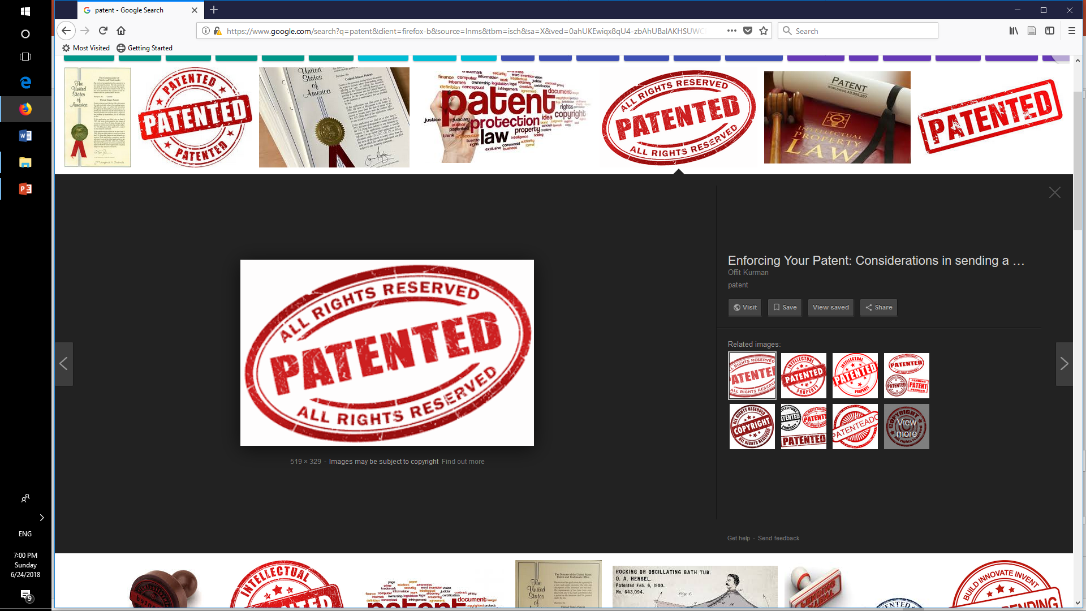


Outlook
Method elaboration for detection
of other sorts of beverages
Shape & size optimization
Marketing & commercializing opportunities
Built-in programming
Attractive design

Slide 23
References
[1] Alicyclobacillus spp. Control in the Fruit Juice Industry
[2] Microbiology of soft drinks and fruit juices (P. Wareing and R.R.) Davenport
[3] http://dairyprocessinghandbook.com/chapter/chemistry-milk
[4] Shinde Kajal P. et al IoT based detection of microbial activity in raw milk by using Intel Galileo Gen II in IRJET, india, 2017.
[5] Sung-Yueh Wu et al. 3D-printed microelectronics for integrated circuitry and passive wireless sensors in Microsystems & Nanoengineering, USA,2015
[6] Hans-W. Gellersen et al. The MediaCup: Awareness Technology embedded in an Everyday Object in Telecooperation office, Karlsruhe, Germany, 2001
Fig.6.
[a] https://grabcad.com/library/circuit-board-pcb-mock-example
[b] https://grabcad.com/library/agian-glass-1

Slide 24

Thanks for your attention!

